Slide 1

What to do next
Post-16 options

Slide 2

You have 3 options available to you after Year 11:
Sixth Form
College
Apprenticeship

Slide 3
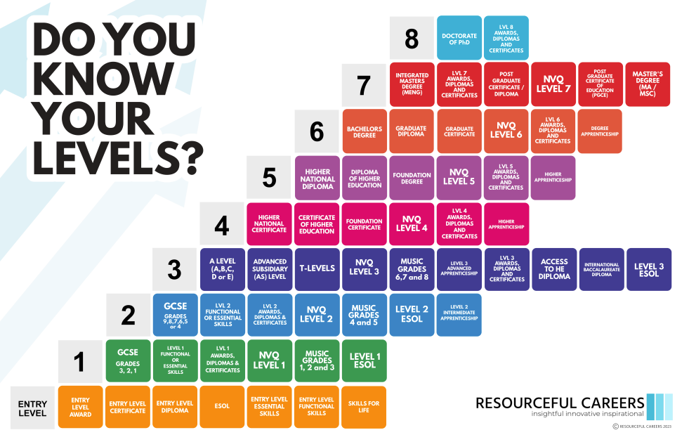

Slide 4

Sixth Form
Academic route – Level 3
Usually leads to university, can lead to apprenticeship or employment
Entry requirements (at least four Grades 4/5 or above)
5 days per week
Subject choice: You choose 3-4 subjects you want to study.
(what you are good at, what you are interested in,
what you need to get to where you want to go)
Local Sixth Forms: Thomas Mills, Farlingaye, Kesgrave, One
Other Sixth Forms: Framlingham College, Wymondham College

Slide 5


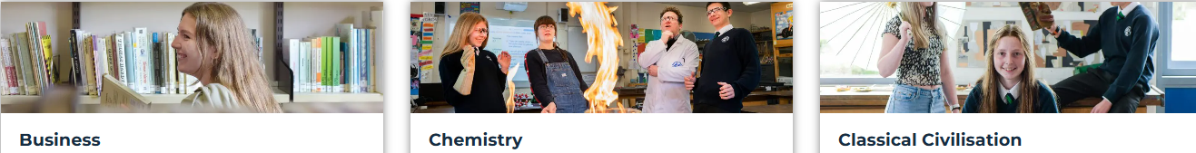


A-level subjects at Sixth Form:

Slide 6




A-level subjects at Sixth Form:

Slide 7




A-level subjects at Sixth Form:
Applied courses at Sixth Form:

Slide 8

College
Mix of academic & practical learning – Levels 1, 2 or 3 and T-Levels
Usually leads to employment or apprenticeship, can lead to university
Entry requirements (depends on what level the course is that you want to do)
3 days per week + potential re-sits in English/Maths + work experience
Subject choice: You choose one course.
(what you are good at, what you are interested in,
what you need to get to where you want to go)
Local College: Suffolk New College (Ipswich, Rural - Otley, On the Coast – Halesworth
& Leiston)
Other colleges: East Coast College (Lowestoft or Great Yarmouth),
West Suffolk College (Bury St Edmunds),
City College Norwich, Access Creative College (Norwich)

Slide 9
Courses at Suffolk New College:
Agriculture
Business
Art & Design
Animal Management
Childcare
Engineering
Hair & Beauty Therapy
Construction
Floristry, Horticulture, Arboriculture
Health & Social Care
Forensic & Criminal Investigation
Games Design
Music Performance & Production
Sport
Uniformed Public Services
Media

Slide 10

T-Level
A relatively new qualification developed by the education sector and leading employers – Level 3 (equivalent to 3 A-Levels)
Can lead to employment, apprenticeship or university
Entry requirements: usually 5 GCSEs at grade 4 or 5
80% classroom learning + 20% industry placement (work experience)
Subject choice: You choose one course.
(what you are good at, what you are interested in,
what you need to get to where you want to go)
Local College: Suffolk New College (Ipswich or Rural) or other colleges

Slide 11
T-Levels at Suffolk New College:
Design, Surveying & Planning
Education & Childcare
Computer Science & Technology
Engineering, Manufacturing, Processing & Control
Health & Medical Studies
Business - Operations
Biomedical & Applied Science
Animal Care & Management

Slide 12

Apprenticeship
Mainly practical learning on the job – Levels 2-7 (Intermediate L2 or Advanced L3)
Usually leads to employment, can lead to university
Entry requirements (depends on apprenticeship)
4 days full-time work + 1 day at college
Apprenticeship in the profession you would like to train in
Employment contract & pay
More information: http://apprenticeshipssuffolk.org
www.thesource.me.uk
www.suffolk.gov.uk/jobs-and-careers/apprenticeships/

Slide 13


Who can I talk to?
Mrs Treeby
Sixth Form team (Mr Cann, Mr Anthony)
Your Tutor, your Head of Year
Subject teachers
Parents, family & friends
Where can I get more help?
Xello (button on our Intranet)
National Careers Service

Slide 14


TOP TIPS
Do your RESEARCH!
Visit OPEN EVENTS to have a look at facilities and talk
to staff about the courses.
Apply for EVERYTHING you might be interested in!
Have a back-up plan!
Be ready for THURSDAY, 20th August 2026!

