Slide 1
Meine Schule My School
Thomas Mills High School: About My School

Slide 2
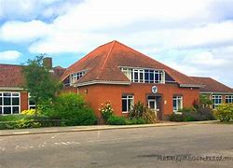
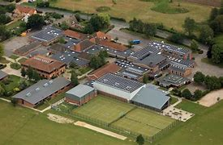
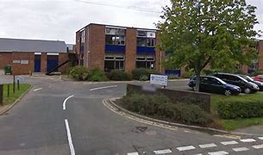
Das ist meine Schule
That is my School

Slide 3
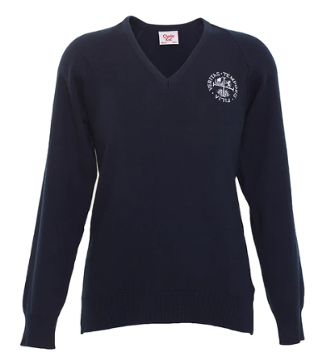
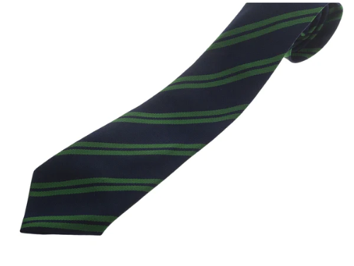
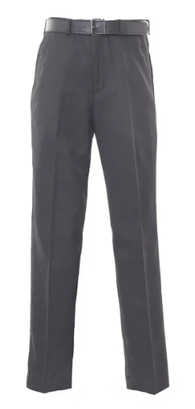
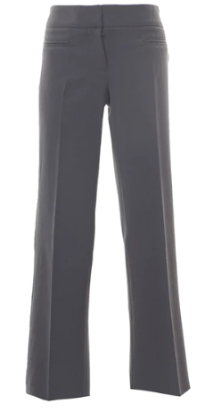
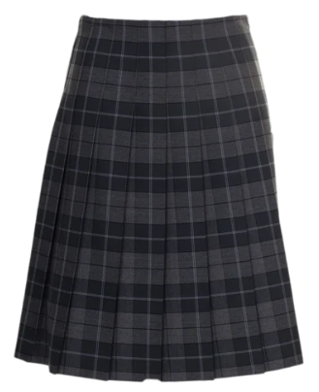
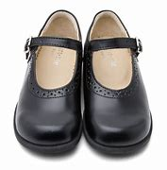
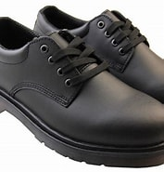
Mann Boy Girl Frau
PULLOVER
Jumper
Schuluniform
blaue und grüne Krawatte Blue and green Tie
OR
Rock
Skirt
graue Hose Grey Trousers
schwarze oder braune Schuhe Black or Brown Shoes
School Uniform

Slide 4
German – Deutsch French – FranzÖsisch Spanish – Spanisch Latin – Latein Foreign languages – Fremdsprachen English – Englisch Maths – Mathe Biology – Biologie Physics – Physik Chemistry – Chemie
Sciences – Naturwissenschaften music – Musik Art – Kunst Religion – Religion
Sports/PE – Sport
Geography – Erdkunde
History – Geschichte
Drama – Theater
IT - Informatik

Slide 5
Über Fremdsprachen (about Foreign Languages)
Turn the page!

Slide 10
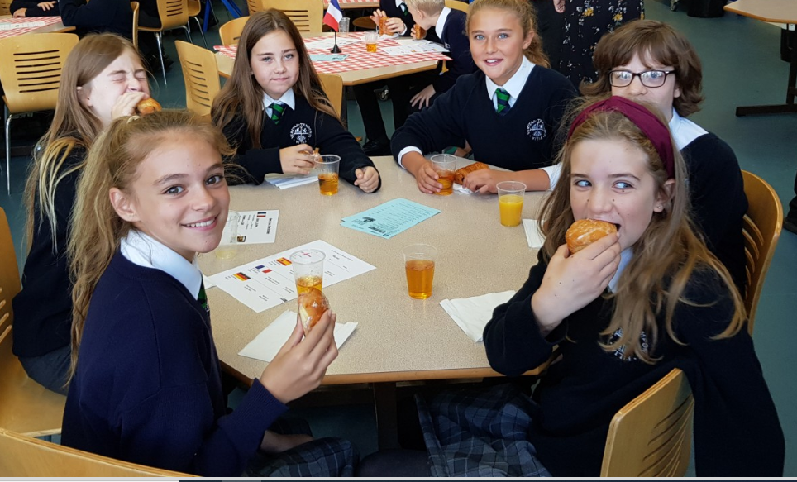
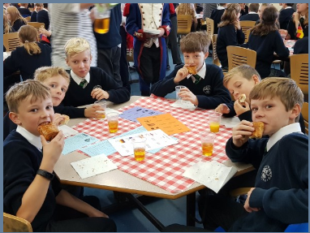
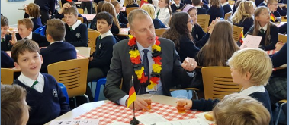
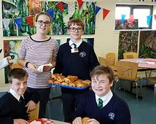
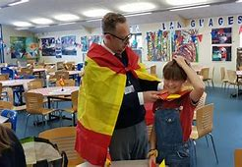
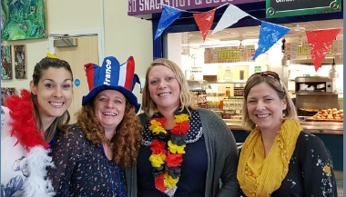
Internationaler Tag der Sprachen Frühstück
International day of languages breakfast

Slide 11
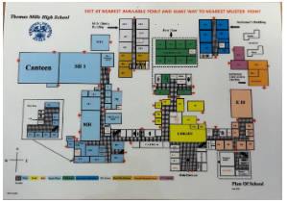
Das ist das Schullayout
This is the school layout

Slide 12
Quiz Time
Try your best to answer the question answered in the PowerPoint!

Slide 13
What subject is Deutsch?
??

Slide 14
German
Start off easy!

Slide 15
Is French or German more Popular at Thomas mills high school?
??

Slide 16
German
Stated in slide 9, Quote:
‘French at Thomas mills is not as popular as German; this means that the classes tend to be smaller.’

Slide 17
What colour is the school Tie?
??

Slide 18
blaue und grüne
Stated on slide 2, Quote:
blaue und grüne

Slide 19
What is Fremdsprachen
??

Slide 20
Fremdsprachen is Foreign Languages
Stated on slide 4

Slide 21
What is Naturalwissenshaften
??

Slide 22
Science!
Stated on slide 4

Slide 23
Well done you completed the quiz
CONGRATULATIONS!!!!

Slide 24
Thanks a lot for reading through my powerpoint, hopefully you now have a wider idea of our school and German!
THANKS

